Slide 1
Hongfei Chen, Jingyu Chen, Daniel Thomson, Scott Baker, Mohamed Khaled 2rd Mar 2018
μCavLab Presentation 3

Slide 2
Previous stage review
Initial design had been completed, including the circuit and chassis of the pod
We have also run ROS on the micro control unit to collect data from the GPS.

Slide 3
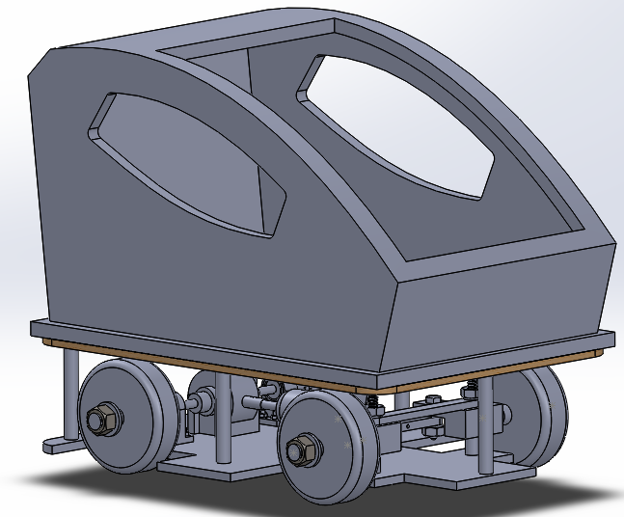
Current overall achievement

Slide 4
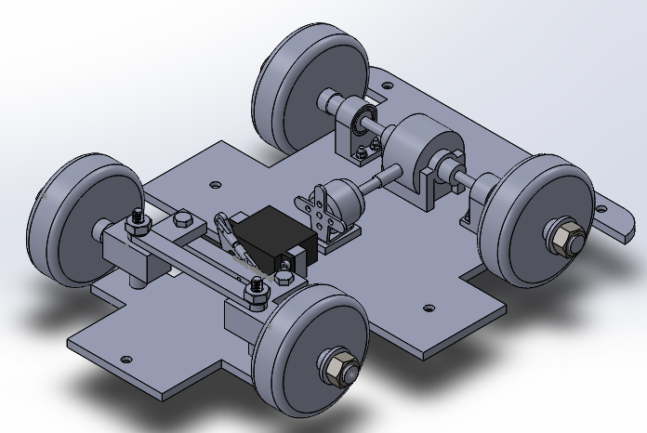

Slide 5
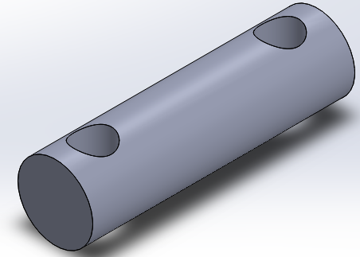
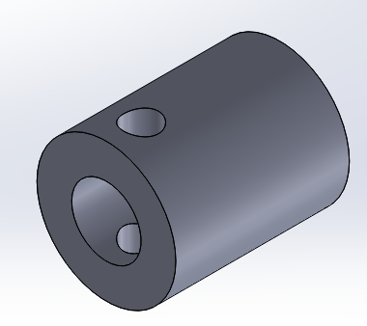

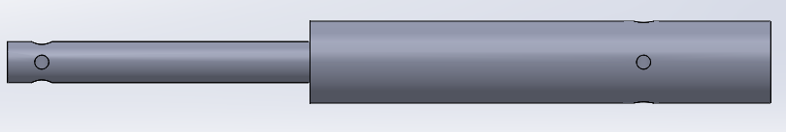
Design Developments
Simplified the rear axle from driveshaft attached to link, attached to the wheel rod
Is now designed as one continuous part

Slide 6
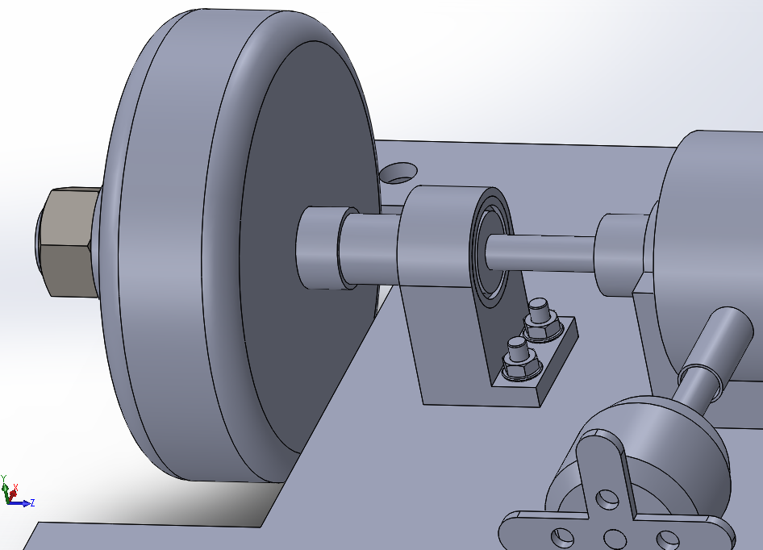
Design Developments
Bearing housings have been designed according to the differential purchased

Slide 7
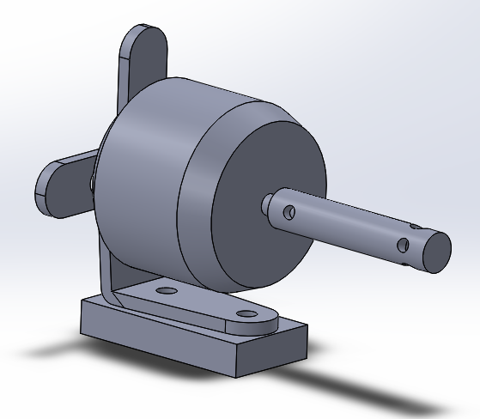
Design Developments
Link between the motor and the differential has been designed
Mount to ensure the motor is stable and situated at the right height to work with the differential has been designed

Slide 8
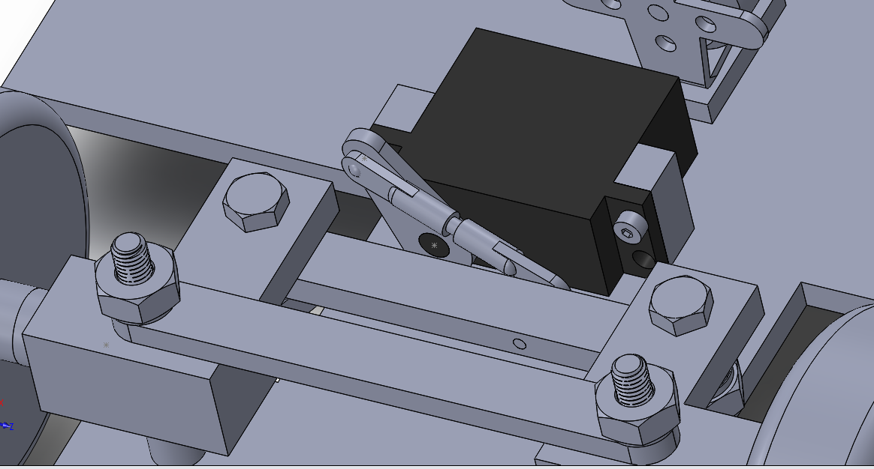
Design Developments
Fastenings to secure the servo motor have been designed
Ball joints have been modelled accurately to give accurate steering system

Slide 9
Completed Part List
Everything has been modelled exactly to allow for a complete parts list
This includes the number of screws, nuts and washers needed
This will allow us to make a thorough “instruction manual” for use by someone wanting to assemble our vehicle

Slide 10
Manufacturing
After completing the designs and improvements, from the last meeting, the parts were ready for the manufacturing stage.
There is currently a number of parts that have been submitted for manufacturing.
These are: driveshafts, bearing housings, motor mount and the servo fastenings
Numerous parts require adjustments: differential, chassis and the servo steering attachment
These drawings, as shown on the following slide, have been accepted by the workshop but are expected to take some time.
We are therefore looking into alternate sources for manufacture

Slide 11
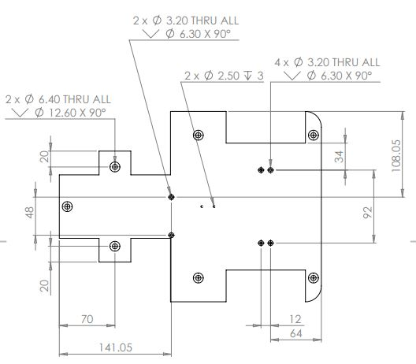
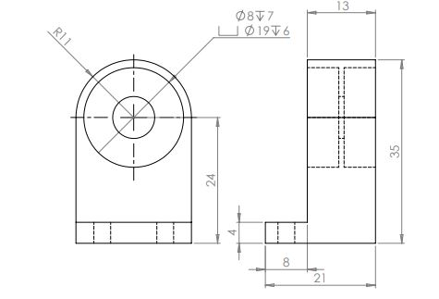
Examples of Part Drawings

Slide 12
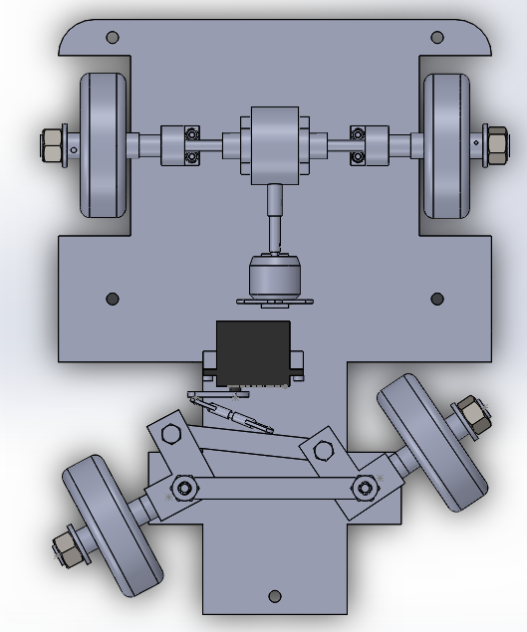
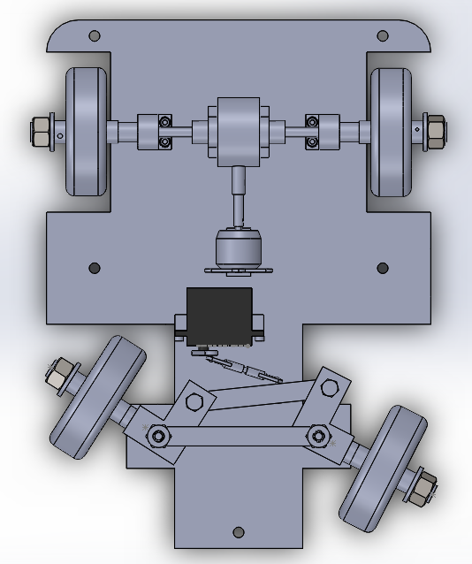
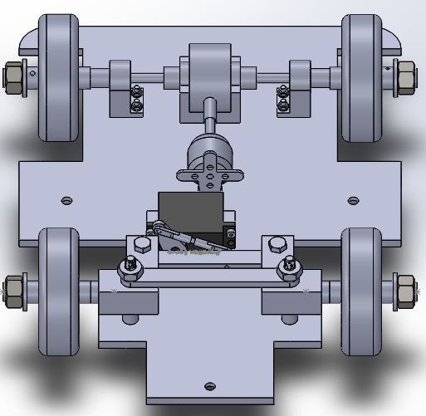
Steering angles
Maximum clockwise servo rotation
40° anticlockwise servo rotation

Slide 13
Steering Angles
The servo attachment starts at an angle of 28° clockwise
Current estimation of the steering angles:
For 40° anticlockwise rotation – wheels turn right at average angle of 30°
For maximum clockwise rotation (62°) – wheels turn left at average angle of 30°
Due to off centre starting position can rotate anticlockwise further
Relationship between the servo rotation and the wheel rotation is non-linear.

Slide 14
Next Steps
Upon completion of the manufacturing assemble the vehicle
Attach the electronic components
Test the vehicle

Slide 15
Battery and motor capabilities
4300mah Li-po battery for the motor and servo
Servo current draw 5 – 300mah
Motor current draw 5 – 9A (Under load)
Motor max rpm = 7.4 x 1380 = 10212

Slide 16
Battery and motor capabilities
Wheel rpm @ 24km/h = 1932
Differential gear ratio 4.15:1
Motor rpm @ 24km/h = 8018 (78.5% of max)
Using 5-9A range, this relates to 8.14A
Assuming 0.2A servo draw
4.3/8.34 = 31 minutes battery life.

Slide 17
Battery and motor capabilities
Theoretical top speed:
Max motor rpm = 10212
Wheel speed @ max motor rpm = 30.5km/h
Battery life @ max motor rpm = 28 mins

Slide 18
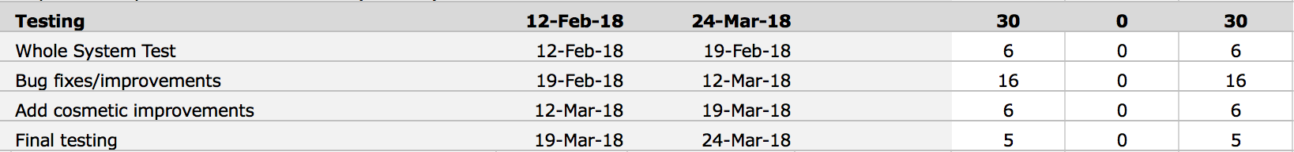
Previous review of electronic goals
1. return and reorder a new ESC
2. solder and connect wires
3. test speed control unit and servo
4. Integrate GPS with compass
Gant chart

Slide 19
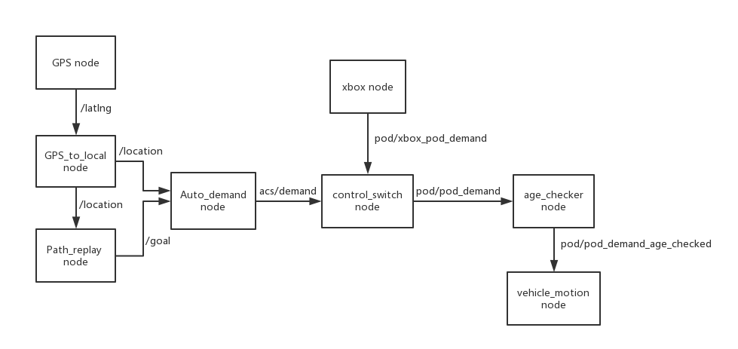
Node diagram

Slide 20
Node specification
GPS node
Gps to local
path
replay
auto
demand
Xbox node
Control switch
Age checker
Vehicle motion
NEXT

Slide 21
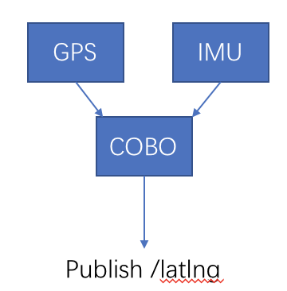
GPS NODE
gps node consists of two nodes:
Adafruit gps
subscribe to /nmea_topic_driver
publish /fix
Compass
No subscriber, read data from I2C and
publish /compass
GPS
/latlng includes:
Longitude
Latitude
heading
QUIT

Slide 22

GPS TO LOCAL
Node to translate incoming GPS co-ordinates into a location in a local frame.
subscribe to /latlng
publish /location
Transform algorithm:
$x=x_{o}+R\cos{{lat}_{o}}\sin{lng−{lng}_{o}}$
$$y=y_{o}+R\sin{lat−{lat}_{o}}$$
$$θ=\frac{π}{2}−heading$$
$\left(x_{o},y_{o}\right)$ is the origin in local co-ordinates, $\left({lat}_{o},{lng}_{o}\right)$ are the GPS co-ordinates of the origin.
To local
QUIT

Slide 23
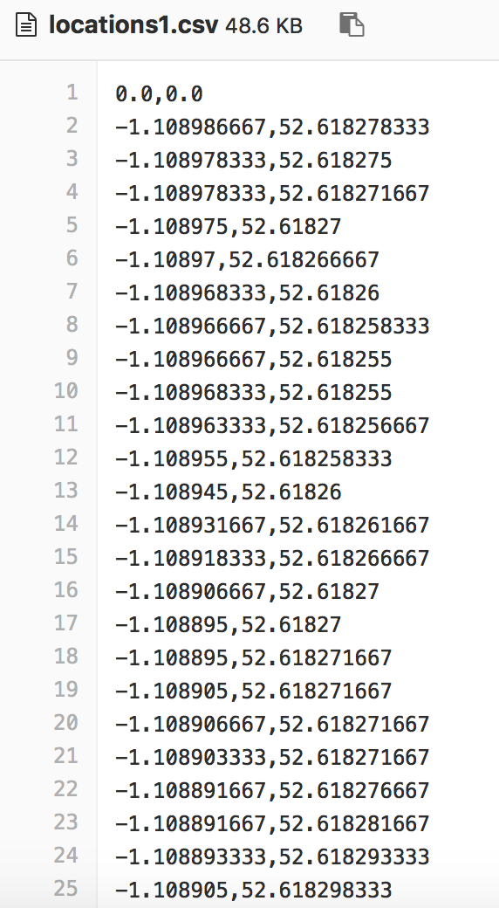
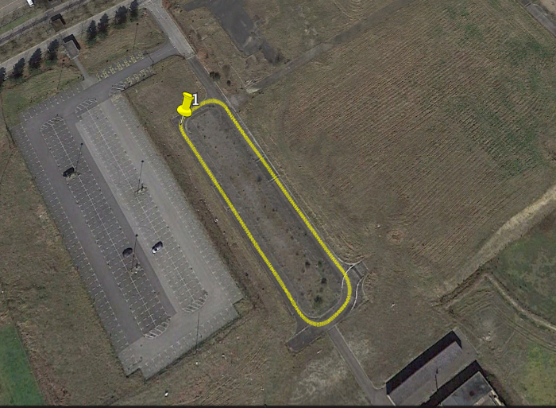
PATH REPLAY
Read a CSV file containing a sequence of GPS co-ordinates (lat, long, heading) and according to this file and its current posiontion, publish /goal
path
QUIT

Slide 24

AUTO DEMAND
This node subscribe to
/location and /goal
Through the algorithm :
$$Κ=Κ_{l}\frac{e_{l}}{r}+Κ_{ψ}e_{ψ}$$
To calculate the speed and the steer
Publish /demand:
Including speed and steer
demand
QUIT

Slide 25

XBOX NODE
xbox
/dev/input/js0
Joy stick drivers
XboxJoyNode
/joy
As for xboxjoynode,
publish /xbox_pod_demand
Including speed and steer

Slide 26
Joy.stick drivers
Include the joy_node, a node that interfaces a generic Linux joystick to ROS
This node publishes a “Joy”message, as a topic sensor_msgs/Joy

Slide 27
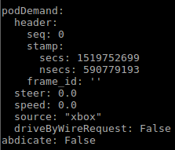
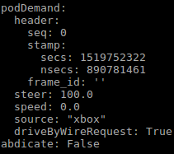
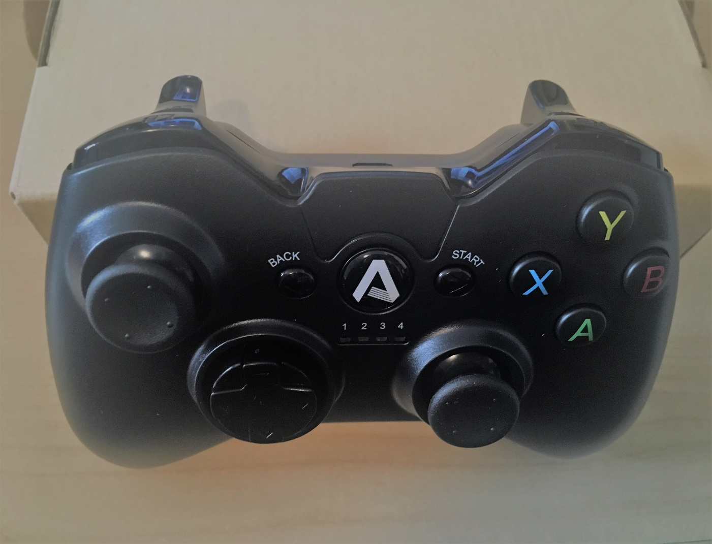
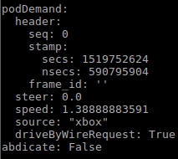
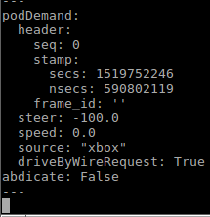
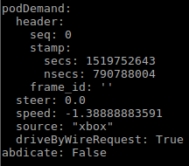
Control switch
此处是第一个项目要点
此处是第二个项目要点
此处是第三个项目要点
Quit

Slide 28
CONTROL SWITCH
The control switch has one or more prioritised pod demand sources in a prioritised list.
At any time the active source is the highest priority source that is not abdicating; its pod_demand is published by the node.
So the vehicle has two modes:
Drive by xbox controller
Autonomous driving
switch
QUIT

Slide 29
AGE CHECKER
The age checker republishes all incoming messages provided that they are no older than age_to_start_ramp. Once the most recent demand is older that age_to_start_ramp, the speed in the demand is reduced linearly down to zero after age_to_stop.
publish checked speed and steer
checker
QUIT

Slide 30

VEHICLE MOTION
This node is under development now and its function is to transform speed and steer from /pod_demand_age_checked
to a PWM signal which will be sent to the servo and motor.
motion

Slide 31





Vehicle motion
$$R=\frac{L}{\tan{θ_{i}}}$$
$$K=\frac{1}{R}=\frac{tanθ_{i}}{L} steer:rad/m$$
L
$${θ_{i}=tan}^{−1}{KL}$$
$$θ_{i}$$
Temporary function applied:
Clockwise: $θ_{servo}=θ_{i}$
Anticlockwise: $θ_{servo}={2θ}_{i}$
R

Slide 32
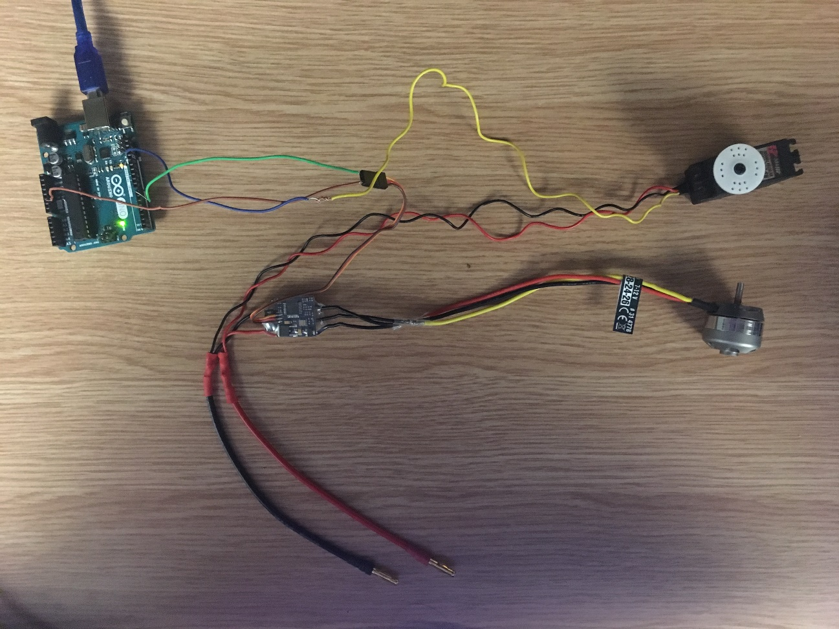
Vehicle motion
The motor and servo has been tested running normally
Current working on the function to correspond speed/steer value to pwm value

Slide 33
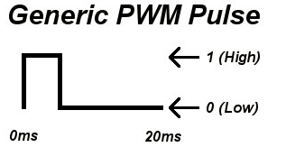
Speed control
Standard PWM period fix at 20ms （50Hz），theoretically the pulse width is between 1ms and 2ms ,But, actually it can be from 0.5ms to 2.5 ms，the pulse width correspond to the 0-180° in servo library function

Slide 34
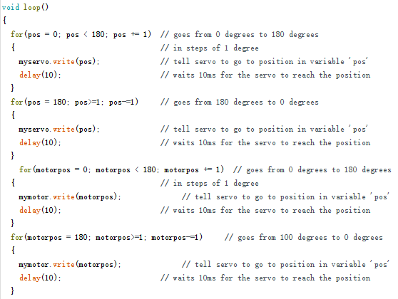
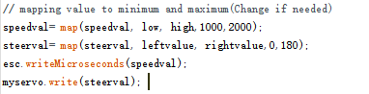
Vehicle motion
Simple test
1000 (uS）is fully counter-clockwise, 2000 is fully clockwise, and 1500 is in the middle.
90° is in the middle, 0° is fully left and 180° is fully right.
Quit

Slide 35
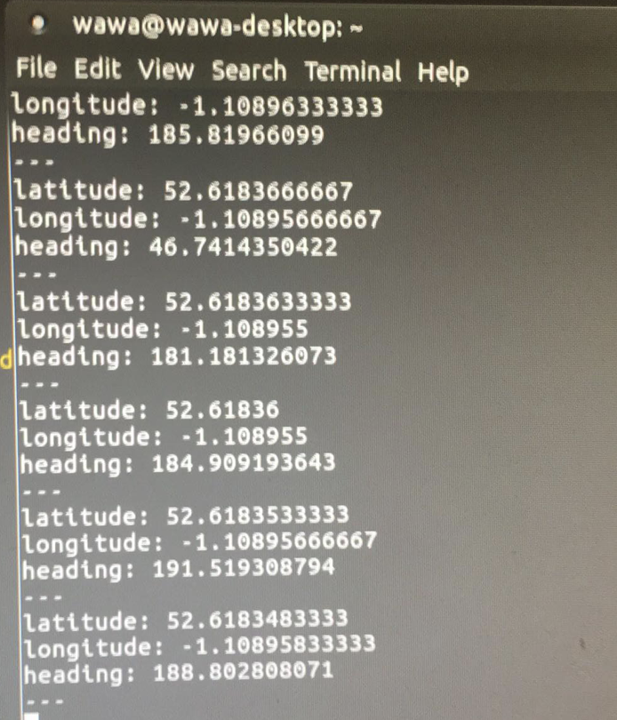
Node construction
GPS node consist of two nodes:
The combination has three choices:
1. 2. 3.
GPS
IMU
GPS
IMU
COBO
IMU
GPS
Publish /latlng
Publish /latlng
Publish /latlng

Slide 36
Node construction
The main problem is the accuracy and the data transfer frequency of the sensors.
The compass still needs to be calibrated to decrease the error and the updated frequency of GPS information is only 1Hz and seems to be slower than we estimate.

Slide 37
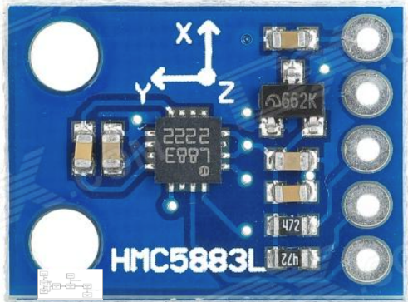
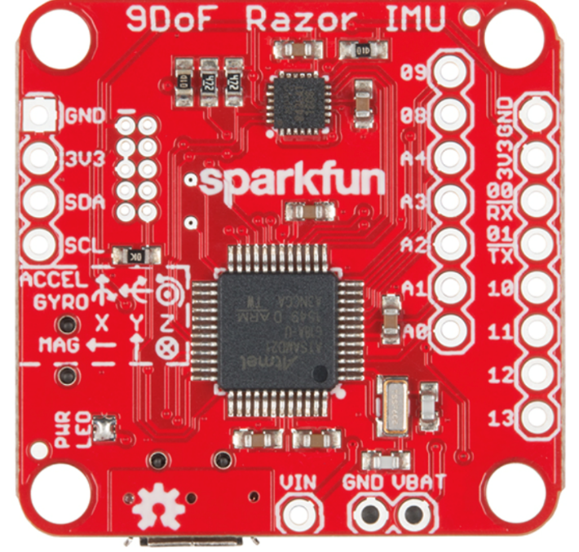
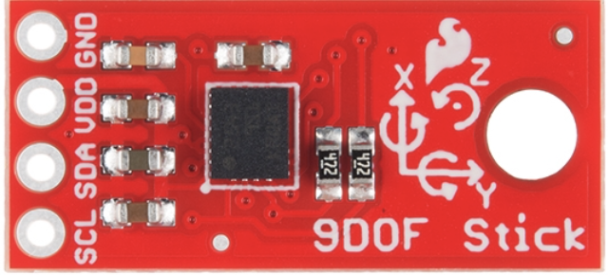
Sensor calibration
Hmc588l
Razor imu
Sensor stick imu
The senor we used for the compass still has a little error and sometimes a little drift. Therefore, we need to calibrate it later.

Slide 38
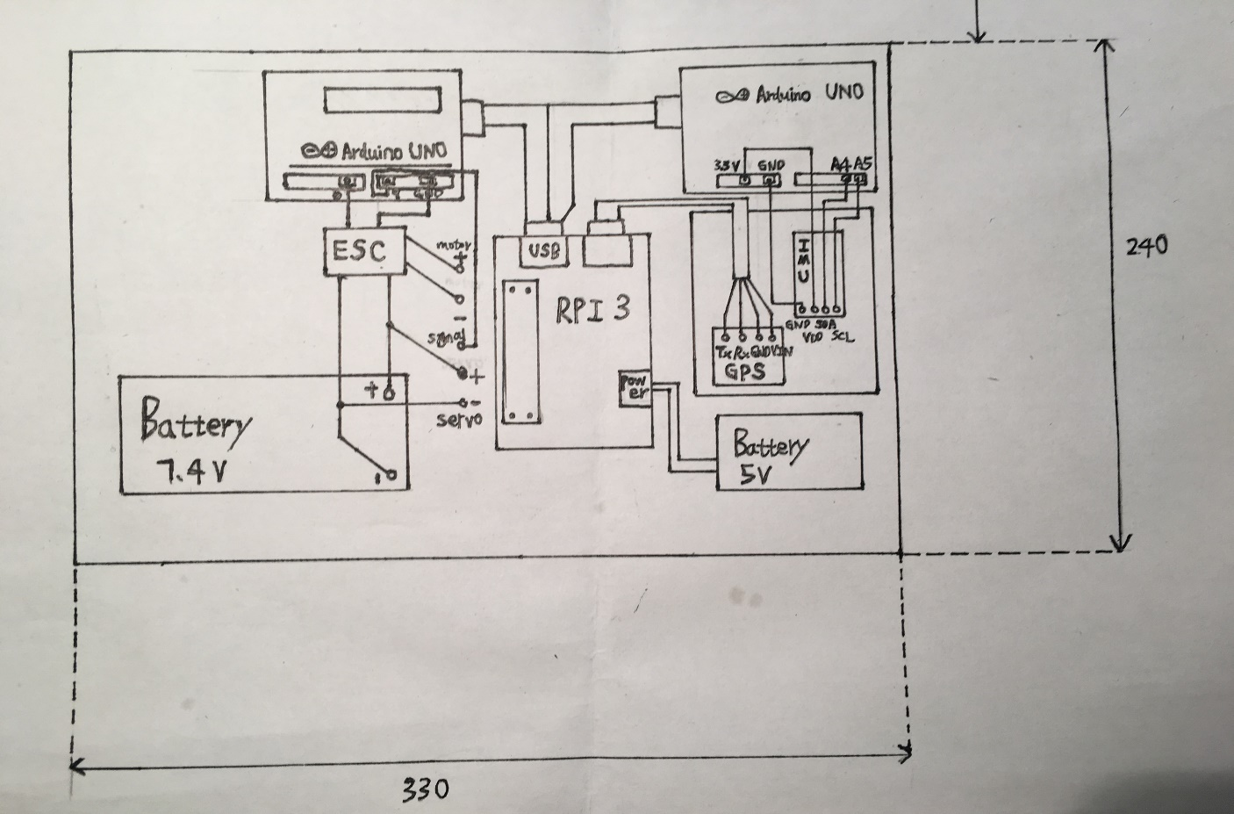
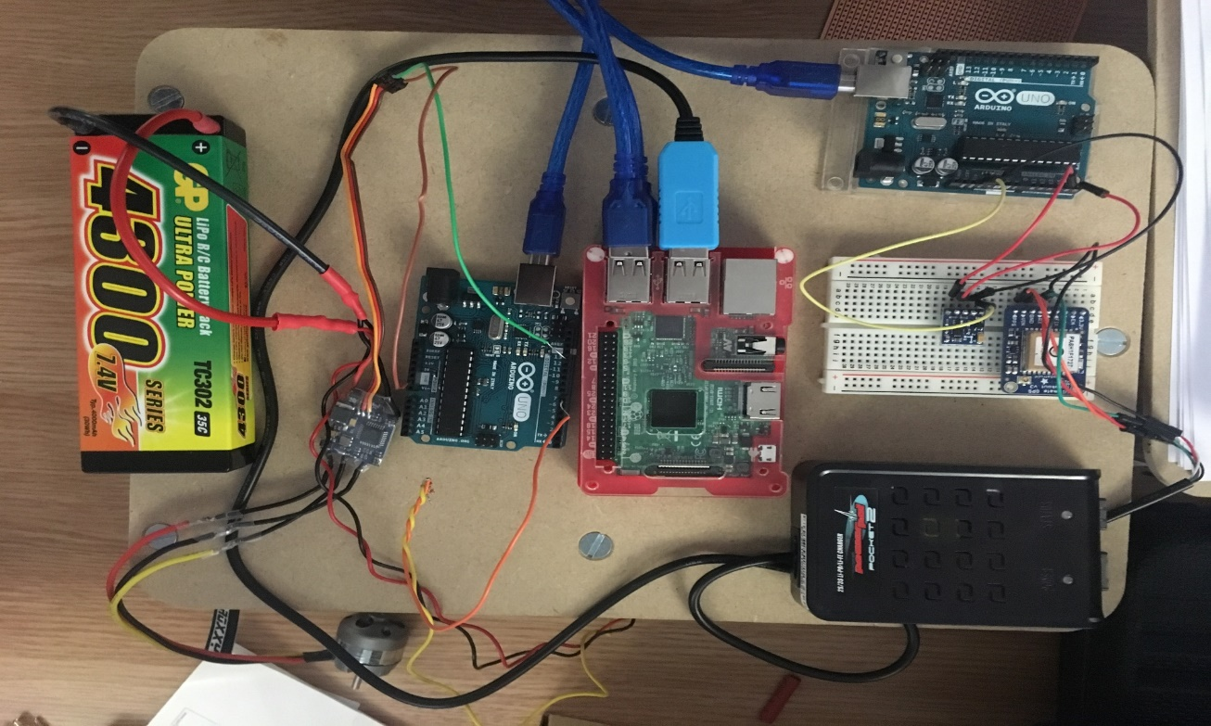
Circuit design
Arduinos X2
raspberry pi X1
IMU X1
GPS X1
Battery 7.4V X1
Battery 5V X1
Motor X1
Servo X1
ESC X1

Slide 39
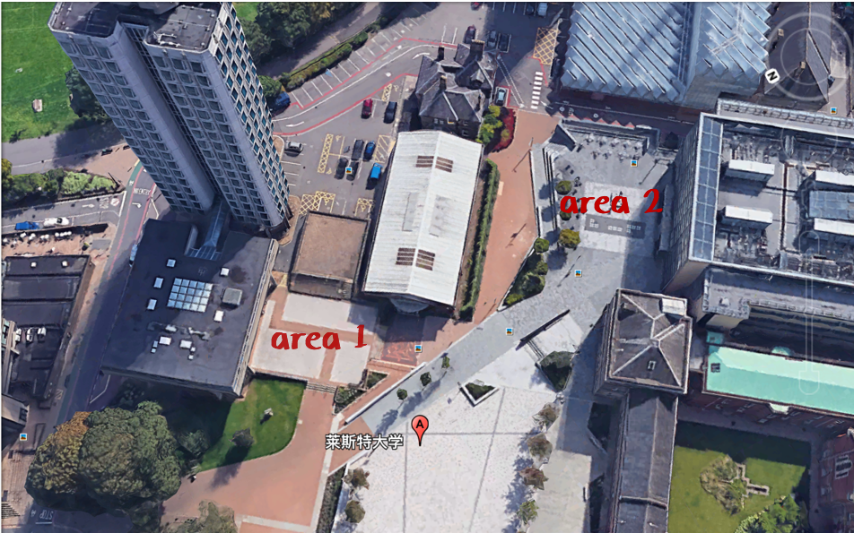
Next steps
Calibrating sensors
Implementing position mapping
Complete vehicle motion node
Launch all the nodes
Real Vehicle testing
Algorithm revise

Slide 40
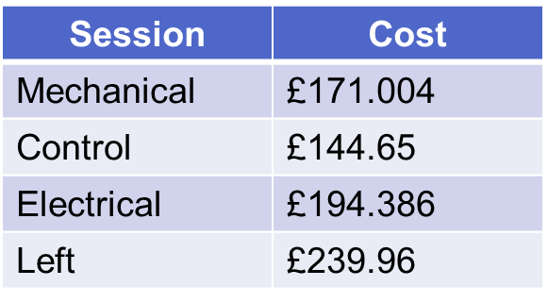
Summary
Total: £150*5=£750

Slide 41
Summary
Currently, the whole design has begun to take shape
The whole pod is expected to be assembled before the Easter holidays

Slide 42
Thanks for watching

